Slide 1


Slide 2
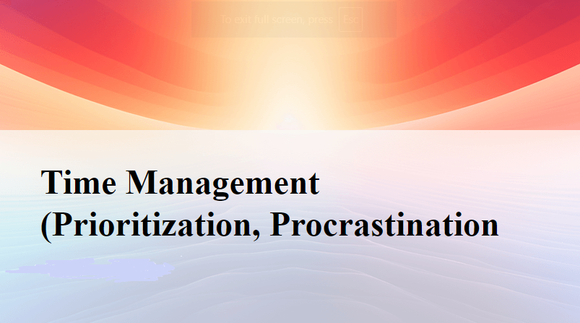

Slide 3
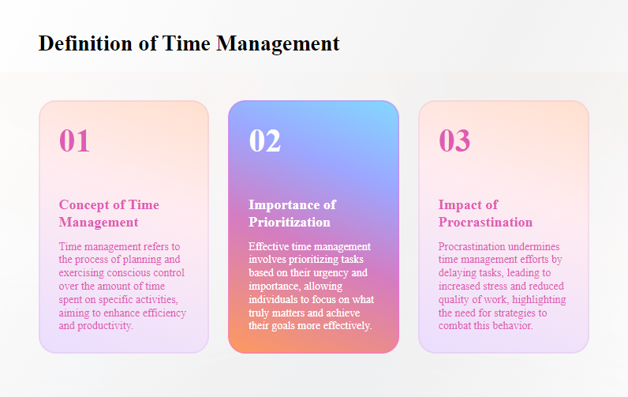

Slide 4
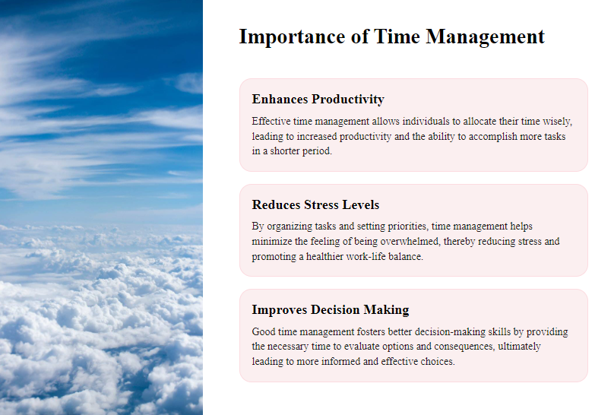

Slide 5
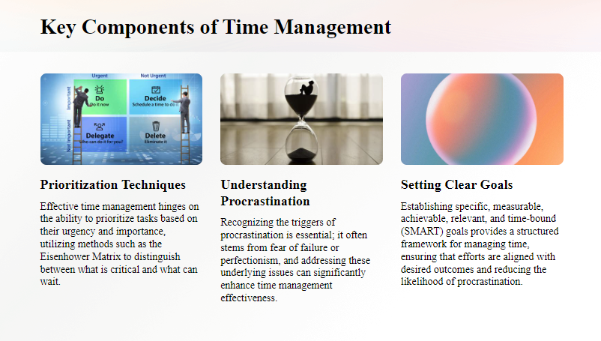

Slide 6
Effective time management skills include:
Setting SMART goals
Effective planning
Stress management
Proper task delegation
Avoiding distractions
Single-tasking
Saying "No
Setting priorities
Beating procrastination
(check out notes in ppt)
Notes:
Effective time management skills include:
Setting SMART goals — make sure the goals you set for yourself are Specific, Measurable, Attainable, Relevant, and Time-bound.
Effective planning — make sure you have clear objectives, as well as defined tasks and resources in order to make a clear plan that will lead you to your goals.
Stress management — make sure you manage your stress with stress relieving strategies and tactics, in order to feel more relaxed while doing your work.
Proper task delegation — delegating tasks helps you ease the workload and share it with competent colleagues and employees.
Avoiding distractions — distractions take away from the time you should be working (or even relaxing), so you should learn how to avoid them.
Single-tasking — focusing on one task at a time helps you deliver quality end results much better than when you multitask.
Saying "No" — this little two-letter word will help you save more time for your own priorities.
Setting priorities — Investing time into the right tasks will ask for less effort, but bring better results. This is also known as the 20/80 rule, or the Pareto principle.
Urgent and Important: Do these tasks immediately.
Important but Not Urgent: Schedule these tasks for later.
Urgent but Not Important: Delegate these if possible.
Neither Urgent nor Important: Consider dropping these tasks.
Beating procrastination — Identify the causes of your procrastination and tackle them.

Slide 7
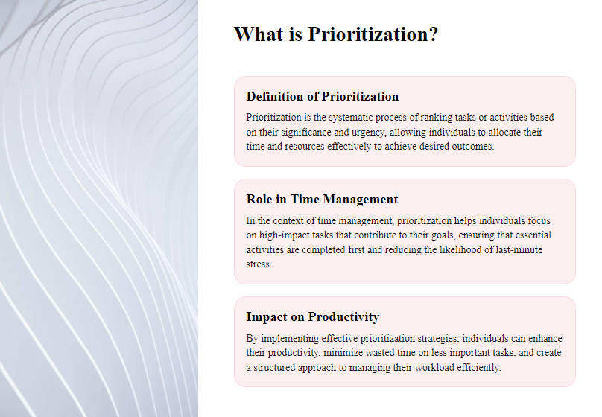

Slide 8
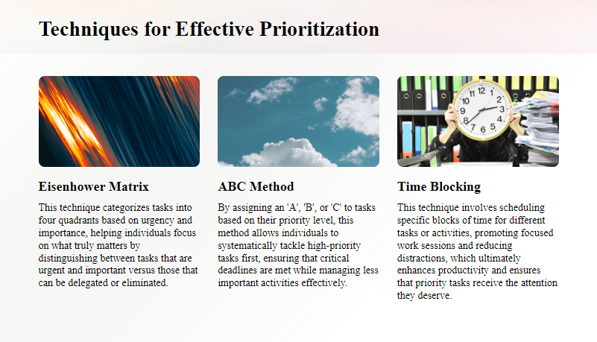

Slide 9
TECHNIQUE FOR PRIORITZATION:
Eisenhower Matrix
ABC
The Pareto Principle (80/20 Rule)
Moscow Prioritization Method.
Getting Things Done
Time boxing
The Pomodoro Technique
Kanban
1-3-5
Rapid Planning Method (RPM)
Parkinson’s Law
The ALPEN Method
Who’s Got the Monkey
The Pickle Jar Theory
Posec method
Eat that frog
ABCDE method
Notes:
Timeboxing
This technique works on the bases of timeboxes. Timeboxing often includes fixed deadlines so project managers generally use it.
It works in a way that you allocate time periods (timeboxes) to activities, you work within this time period and then stop once the set time runs out.
The steps are:
First, you lay out all your activities and tasks on a list
Then decide what you want to accomplish with these tasks i.e. define your goals
If a task is important and requires great focus then allocate a longer time period to it (For example 2-3 hours)
If the task is difficult then parse it and allocate shorter time periods (For example 20-30 mins) to parts of it so that task is easier to manage
Now start from your first task, and work your way down
When the allocated time for a task is over, stop working on it and take a break
Review what you have managed to finish
Then turn your attention to other timeboxes in your schedule
Kanban
This is one of the visual time management techniques that help you track the project. It means that you can track how the tasks move across differently labeled columns. Japan developed this to increase productivity and time management in the manufacturing industry.
The way to use this technique is to take project management software, whitepaper, sticky notes, a pen, and paper.
Now determine the number of stages in your project and create columns accordingly.
Create 4 columns and move task within a project across the stages mentioned as follows:
Backlog: Here you do brainstorming and define all tasks to be done in the project. Then you need to determine which task you are supposed to move to “To Do” Column and which task can wait a while.
To Do: This lists the task that you are going to work on.
In Progress: This lists the task you are currently working on.
Done: This lists the task you have already finished.
Eat that frog
This technique aims at prioritizing tasks. First, pick the most important or worst task (This is your frog). Now tackle it as first thing tomorrow. Once you have finished with your frog, you can then move on to other tasks for that day but not before.
It works in a way that you have to identify tasks based on priority and label them.
The most important task is Task A. Hence you should tackle it or face consequences.
Task B is the next most important task and you need to handle it after Task A. This means that it is less important but still vital.
Task C is a task that can be done by you but you wouldn’t face any consequences even if you don’t do it.
You should delegate Task D to someone else and allocate the time of this task to Task A.
Task E is the task you don’t really need to do and you are free to eliminate it.
Who’s Got the Monkey
This technique is based on delegating tasks. It is generally used by project managers. Here monkeys are tasks and you need to consider how to deal with them.
3 types of monkeys and management time defined as follows:
Boss-imposed time: It refers to the activities required by the boss
System-imposed time: This refers to the actions required by a colleague’s requests and questions
Self-imposed time: It refers to the actions you decide to undertake. You may use it for your own tasks and ideas (i.e. discretionary time) or to tackle subordinates problems and request (i.e. subordinated imposed time)
Now your aim is to eliminate subordinate-imposed time, control system and boss imposed time, and increase the discretionary time.
The steps are:
First, recognize and describe the monkey i.e. specify what task is and what actions are needed for its completion
Assigning the monkey i.e.to allocate the monkey to a person
Ensuring the monkey i.e. make sure that the person handles the monkey appropriately
If a monkey is important and allows no mistakes then you should recommend what should be done and act if needed
If you are certain that the person assigned with the monkey can handle it, act and then provide advice
Keep a check on monkey i.e. specify when you will provide follow up for the monkey to make sure that everything is on track
The Pickle Jar Theory
The Pickle Jar Theory uses a metaphor to illustrate an essential point of time management: You must do the most important tasks first; otherwise, you’ll never get around to them.
Here’s the metaphor: Imagine that on a table before you, you have an empty pickle jar, some rocks, some pebbles, and some sand.
The jar represents your time.
The rocks represent the important tasks.
The pebbles are less important tasks.
The grains of sand are the unimportant tasks that pop up throughout your day, such as sending a text message, checking your email, or answering a phone call.
Parkinson’s Law
Parkinson’s Law, created by British naval historian and author Cyril Northcote Parkinson, states that “work expands so as to fill the time available for its completion.” And there’s plenty of proof that’s true. For example, at Microsoft Japan, cutting back to a four-day workweek and limiting meetings to 30 minutes boosted productivity by 40%.
1-3-5 Rule
The 1-3-5 Rule is a technique that helps you manage your tasks.
The idea behind this method is that every workday, you need to focus your attention on:
1 big thing
3 medium things
5 little things
Once you complete your big task, you’ll feel a sense of accomplishment, which will motivate you to continue.
At the same time, medium tasks allow you to progress with your larger projects.
Finally, little tasks are easy to complete, so they’ll also inspire you to move forward.
ABCDE method
In his book How to Get Control of Your Time and Your Life, Alan Lakein talks about the ABCDE method.
Thanks to this technique, you can learn to prioritize your tasks better and finish them before the deadline.
The ABCDE method is similar to the Eisenhower Matrix — but, unlike the latter, the ABCDE technique doesn’t categorize tasks by urgency.
How ABCDE method works
When using this technique, you should organize your assignments into five categories by their importance:
A — most important tasks
B — important tasks
C — nice to do (tasks)
D — delegate these tasks
E — eliminate these tasks
Rapid Planning Method (RPM)
One of the best time management techniques is also the Rapid Planning Method (RPM). The acronym RPM also stands for “result, purpose, and massive action plan”.
This time management technique was created by motivational speaker Tony Robbins.
The idea behind this method is to train your brain to envision what you want in order to make it real.
In general, this technique is practical for setting long-term goals.
How Rapid Planning Method works
Capture — First, note down all the assignments you need to complete this week. Be realistic — write down from 5 to 9 tasks for the week.
Chunk — Group similar tasks together. You can use categories such as “Work tasks”, “Non-work tasks”, “Career”, “Health”, etc.
Make your own RPM blocks. Remember to focus on your most important area and create an RPM block for it. Let’s say that this week, you’d like to focus on “Career”. Use a piece of paper, and create three columns:
Results: Think about the results you’d like to accomplish in this area. Let’s say you want to improve your copywriting skills.
Purpose: Why do you want to achieve this result? For example, you want to enhance your copywriting skills because you’d like to apply for a copywriter job.
Massive Action plan: Then, think about the activities that will help you complete the task and achieve desired results. In this case, you can find relevant copywriting courses and finish 1 course by the end of the month.
Next, create another RPM block for your “Non-work tasks” and other categories for this week.

Slide 10
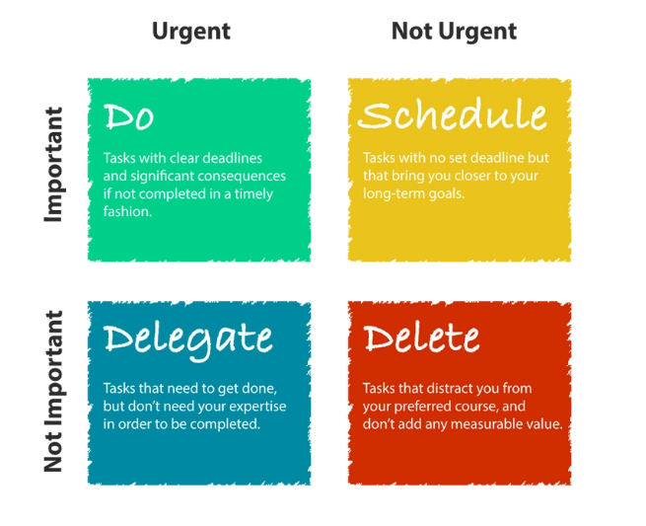
EISENHOWER MATRIX

Slide 11
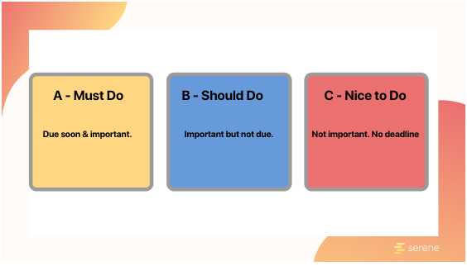
ABC Method:
Notes:
A-B-C Method: Managers originally used the ABC method for supply chain management to determine which stock returned the most value for effort. For the purpose of time management, you apply the technique by grouping your tasks into categories A, B, and C. Similar to the Eisenhower method, each category represents a different priority level:
A = important and urgent
B = important but not urgent
C = not important and not urgent
Take your to-do list and assign each of your tasks to the appropriate category. Now, within each group, prioritize each task.

Slide 12
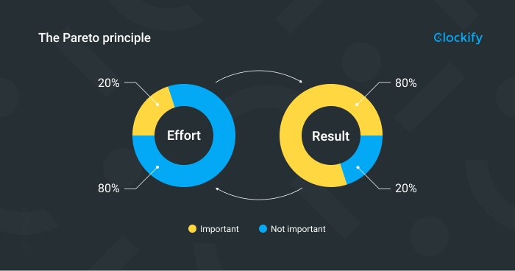
The Pareto Principle (80/20 Rule)
Notes:
The Pareto Principle (80/20 Rule)
The Pareto Principle stems from the economics world and was created by economist Vilfredo Pareto. But it’s applicable in almost any area. So for time management, the Pareto Principle would assert that 20% of the activities you do each day generate 80% of the results. Or, by decreasing distractions by 20%, you can increase productivity by 80%

Slide 13
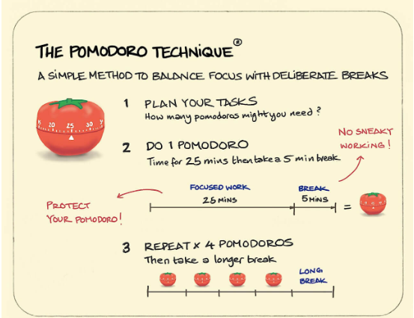
Notes:
The Pomodoro Technique
Developed by consultant Francesco Cirillo, the Pomodoro Technique is a time management tool that breaks work into 25-minute sessions to help you stay focused and get more done.
How Pomodoro works
Set your timer for 25 minutes.
Focus on your work during these 25 minutes.
Stop as soon as the alarm goes off.
Take a 5-minute break.
Resume work for another 25 minutes after the break.
After four 25/5 minute cycles, take a 20-minute break.
Repeat the process until finished with task or project.

Slide 14
Getting Things Done
One of the time management techniques is a five-step method to convert tasks into straightforward ‘To Do” list.
Capture
Clarify
Organize
Reflect
Engage
Notes:
Getting Things Done
The first step is to Capture: Jot down every task that comes to your mind.
The second step is to Clarify: Determine whether a task is actionable and has concrete steps that can be laid out and followed.
The third step is to Organize: You need to file the tasks under different labels with context such as Office, Request from Manager, etc
The fourth step is to Reflect: You need to review the tasks from time to time. This means to determine what is next step for the task?
The last step is to Engage: Once all tasks are listed, identified as actionable, proper filing and task has been reviewed. Now simply start working on them.

Slide 15
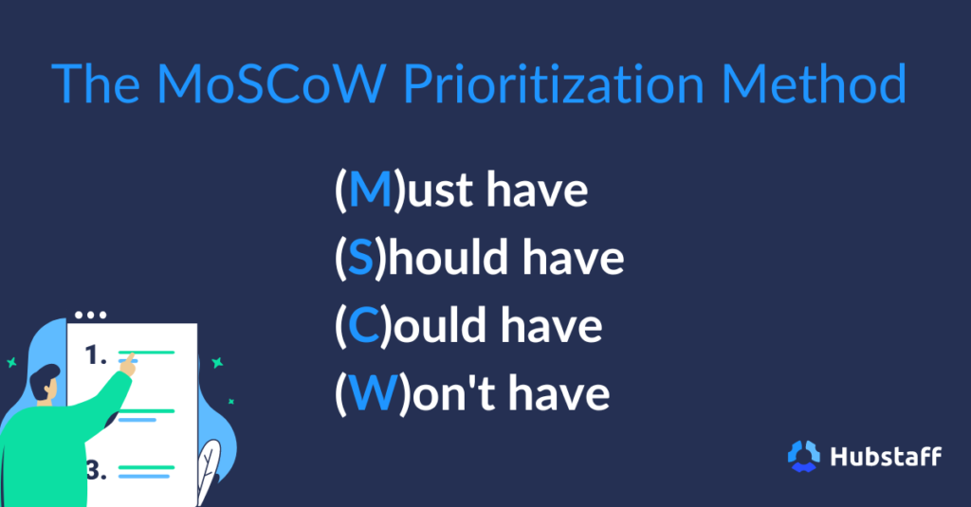
MoSCoW Prioritization Method.
Notes:
The MoSCoW method categorizes tasks into “Must-haves,” “Should-haves,” “Could-haves,” and “Won’t-haves” to prioritize requirements and manage project scope effectively.

Slide 16
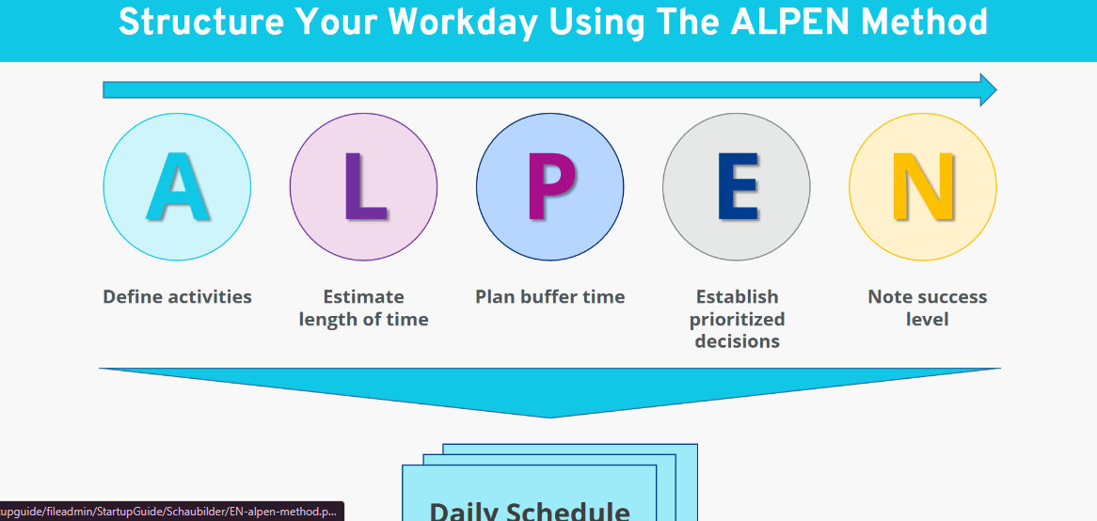
The ALPEN Method
Notes:
Developed by German economist Lothar J. Seiwert, the ALPEN method’s name is an acronym for German words, but here’s how it works:
Step 1: Create a to-do list before you begin the day
Step 2 : Estimate how long each item will take you
Step 3 : Allow 40% as “buffer time” – Things such as breaks & little tasks
Step 4 : Prioritize each task and delegate where you can
Step 5 : Take notes during the day & check off items as they’re completed.
Move any uncompleted items to the next day

Slide 17
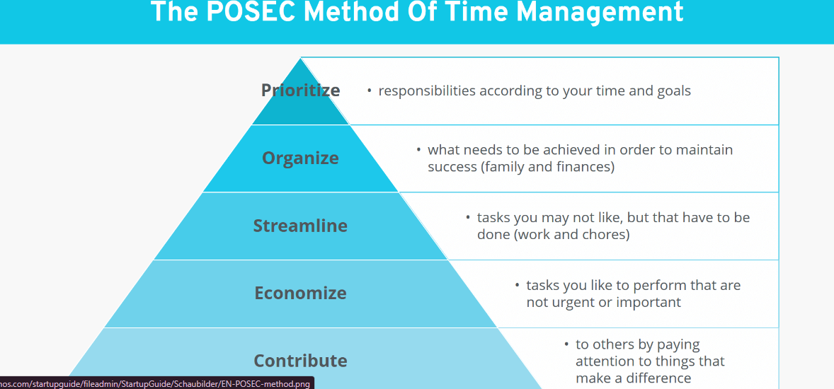

Slide 18
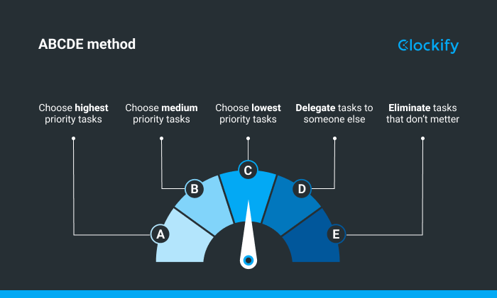

Slide 19
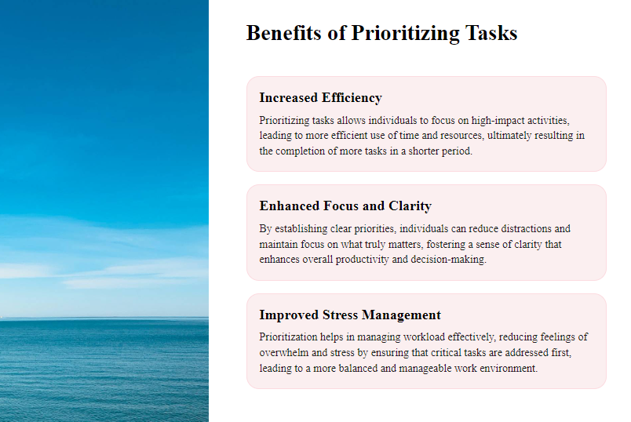

Slide 20
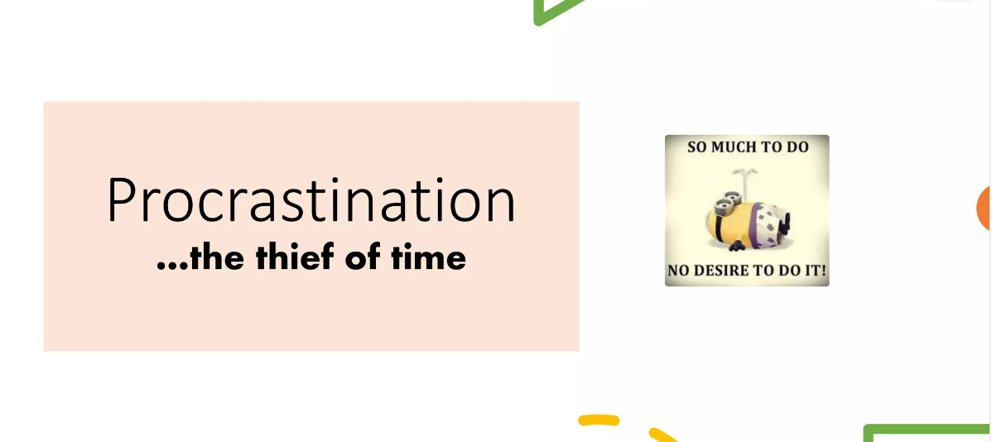

Slide 21


Slide 22
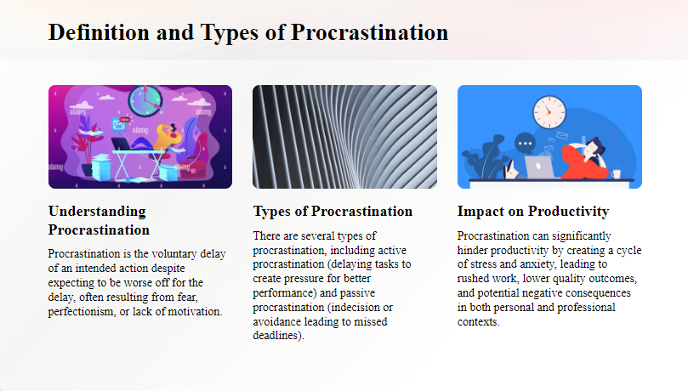

Slide 23
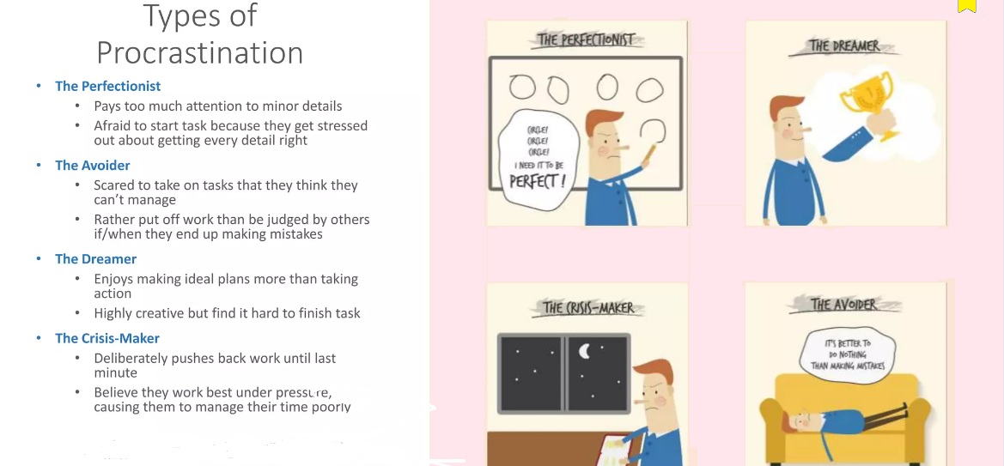

Slide 24
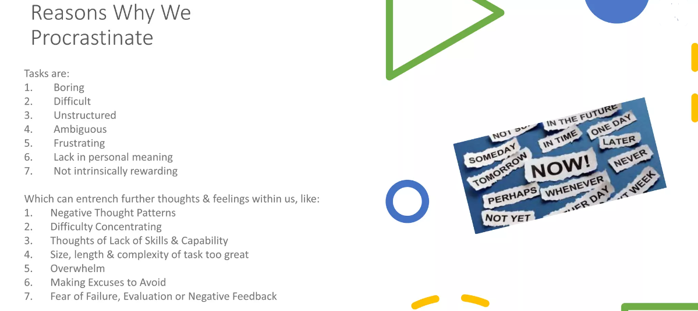

Slide 25
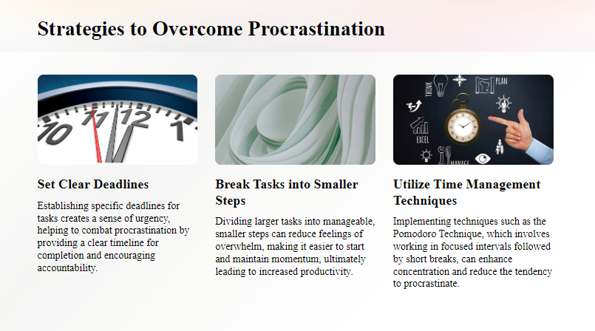

Slide 26
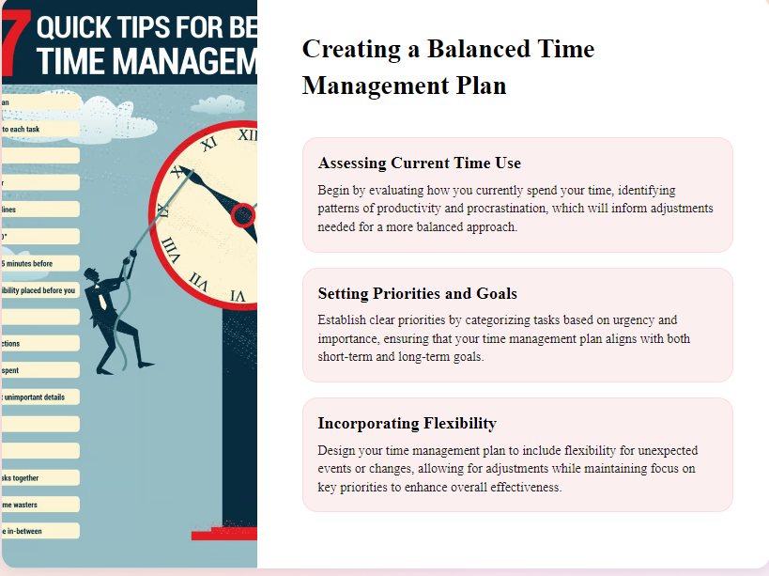

Slide 27
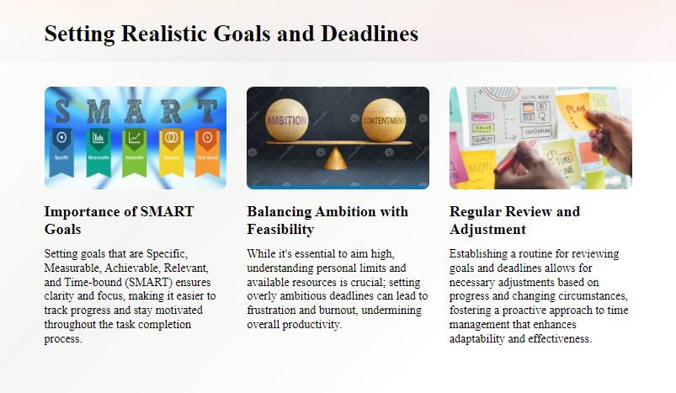

Slide 28
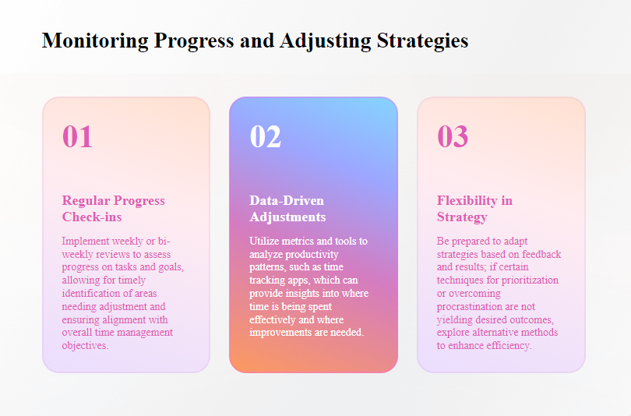

Slide 29
What is the first step in effective prioritization?
Tackling the easiest tasks first
Identifying the most important tasks
Doing tasks randomly
Delegating all tasks
2) Which of the following tools is commonly used for prioritization?
Pomodoro Technique
Eisenhower Matrix
Kanban Board
Mind Mapping
3) What does the Eisenhower Matrix help with?
Organizing tasks by difficulty
Categorizing tasks by urgency and importance
Splitting tasks into small parts
Automating tasks
Notes:
Ans:
B
B
b

Slide 30
4) Which of the following can help reduce procrastination?
Setting vague deadlines
Breaking tasks into smaller, manageable parts
Waiting for motivation to strike
Ignoring important tasks
5) What is a common cause of procrastination?
Lack of interest in a task
High energy levels
Clear goals and deadlines
Effective prioritization
6) How does setting specific deadlines help combat procrastination?
It increases stress and pressure
It provides a clear time frame and encourages focus
It causes task avoidance
It reduces accountability
Notes:
Ans:
4) B
5) A
6) b

Slide 31


